Slide 1

Deep Learning Based vehicle Tracking & speed estimation System in restricted traffic Zones
Presented by:
Salman S (21685)
N Sai Niresh (21667)
R Prasanth Kumar (21673)
Computer Science Engineering
C. Abdul Hakeem College of Engineering & Technology
Melvisharam, Vellore, Tamil Nadu, India
Guide: Mrs. P Revathi HoD : DR k Abrar Ahmed
Batch:32

Slide 2
Abstract / Introduction
This project introduces a Flask-based web application that leverages computer vision to detect, track, and analyze vehicle motion in uploaded videos. It calculates the speed and distance of each vehicle using the YOLOv8 model and perspective transformation, displaying results via an intuitive web interface and downloadable reports.

Slide 3
Problem Statement
Accurate real-time traffic analysis is a growing necessity for urban planning and law enforcement.
Current solutions often lack scalability, affordability, and detailed analytics.
This project addresses these issues by providing a lightweight, accessible system for tracking vehicle behavior from standard video inputs.

Slide 4
Objectives
Detect and track vehicles (cars, buses, motorcycles, trucks).
Calculate and display vehicle speed and distance.
Allow user-uploaded videos for processing.
Provide downloadable Excel reports.
Exclude real-time camera integration and mobile app deployment.

Slide 5
Literature Review
Prior research has used YOLO variants, background subtraction, and Kalman filters for object detection and motion analysis. However, these systems often require complex hardware or lack user-friendly interfaces. Our project enhances accessibility while integrating proven models like YOLOv8 and ByteTrack.
Key References (Compressed):
Lin et al. (2021) used virtual zones and YOLO for real-time vehicle analytics.
Tilon & Nex (2023) proposed UAV-based tracking using segmentation trackers.
Shaqib et al. (2024) leveraged YOLOv8 to enhance urban traffic safety systems.

Slide 6
Existing System
Current systems:
Require CCTV infrastructure.
Are expensive or hardware-dependent.
Offer limited user interaction and data analysis.
Limitations:
No web-based upload interface.
Lack of downloadable, structured data.
No perspective correction for speed/distance accuracy.

Slide 7
Proposed System
Accepts user-uploaded videos.
Uses YOLOv8 and ByteTrack for detection/tracking.
Applies perspective transformation for accurate distance and speed.
Generates annotated videos and Excel reports.
Provides a responsive, modern frontend.

Slide 8

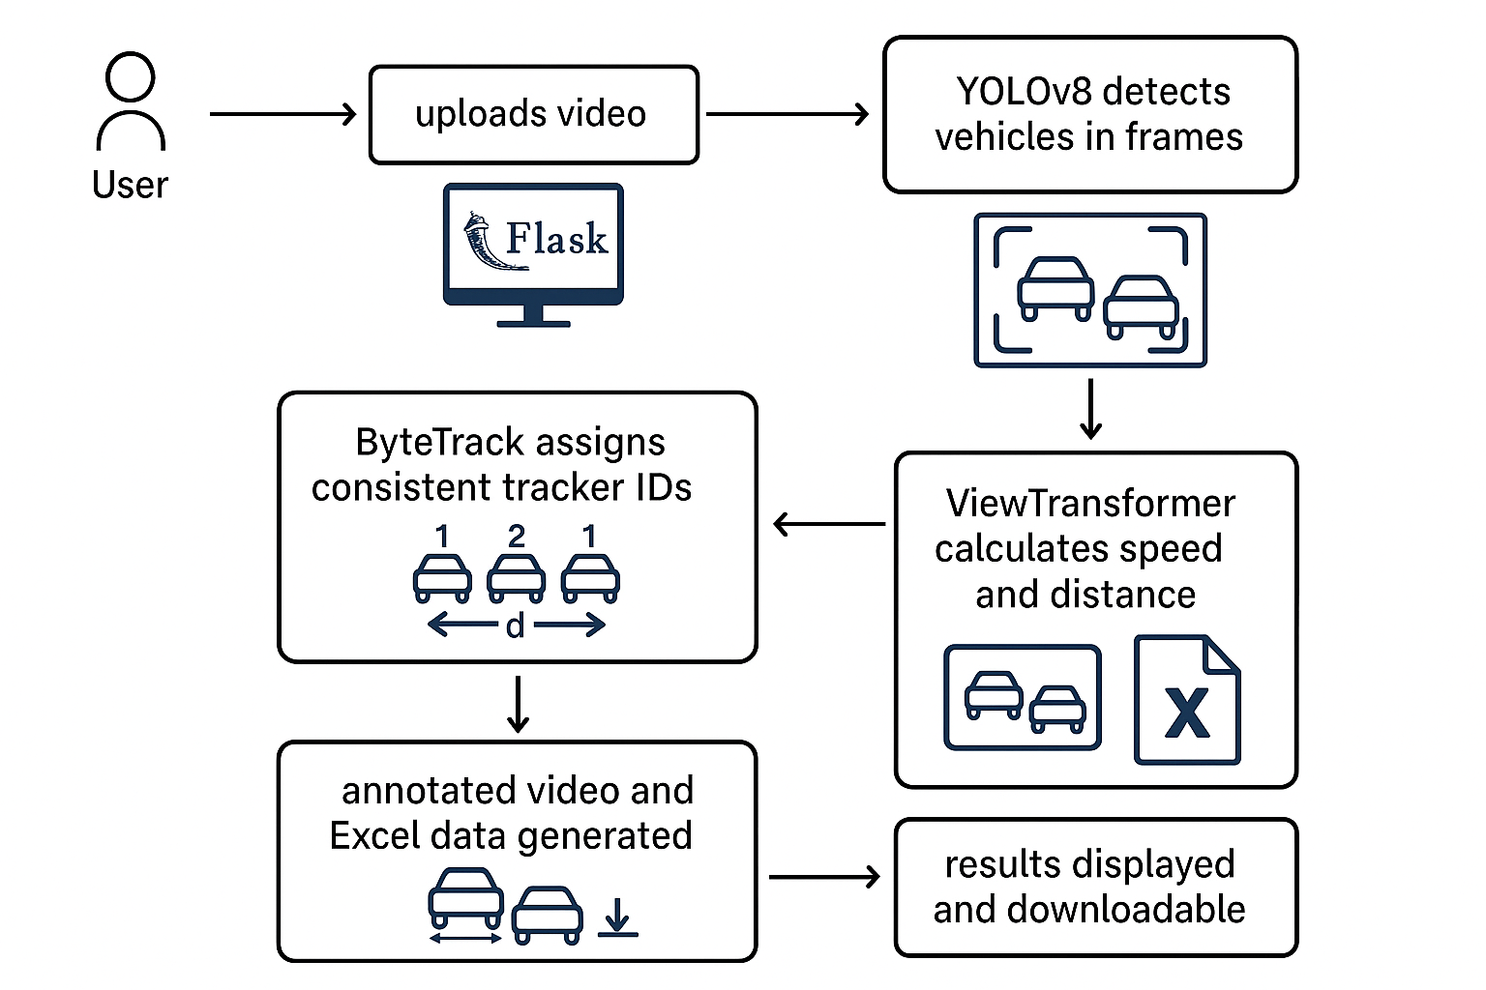
System Architecture

Slide 9
Methodology / Algorithm Used
YOLOv8: Object detection.
ByteTrack: Object tracking.
ViewTransformer: Perspective transformation.
Deque + Frame Rate: Speed and distance calculation.
OpenCV: Frame annotations and video output.

Slide 10
Implementation Tools
Languages: Python, HTML, CSS, JavaScript
Libraries: OpenCV, ultralytics, Supervision, pandas, Flask
Framework: Flask
Database: SQLite (contact form)
Model: YOLOv8 (ultralytics)
Others: WTForms, H.264 codec

Slide 11
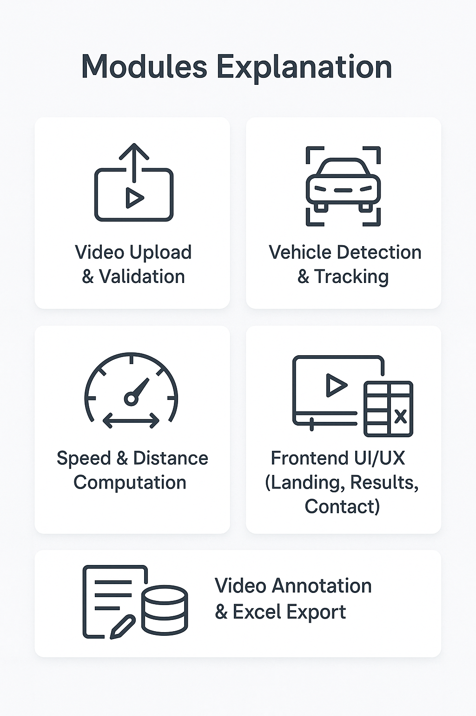
Modules Explanation
Video Upload & Validation
Vehicle Detection & Tracking
Speed & Distance Computation
Video Annotation & Excel Export
Frontend UI/UX (Landing, Results, Contact)
Contact Form & SQLite Storage

Slide 12
Dataset / Input Details
Input: User-uploaded videos (.mp4, .avi, .mov)
Frame resolution: 1280px
Tracker classes: ['car', 'motorcycle', 'bus', 'truck']
No external dataset used; real-world videos provided by users

Slide 13
Results & Output
Annotated video (static/output_.mp4)
Excel sheet (tracker ID, vehicle type, speed, distance, timestamp)
Sample video shows real-time vehicle labeling
Search by tracker ID shows individual vehicle data

Slide 14
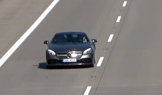
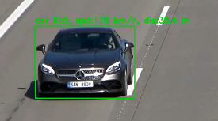
Sample Input/output

Slide 15
Performance Analysis
Accuracy: High precision YOLOv8 (confidence > 0.3)
Efficiency: Processes 30+ FPS videos
Comparison: Outperforms basic motion detection in detail and usability
Scalability: Supports videos up to 500MB

Slide 16
Advantages
Web-based and platform-independent
Annotated results for visual verification
Accurate speed/distance via perspective correction
Simple UI with contact form support
Downloadable structured report (Excel)

Slide 17
Conclusion & Future Scope
The project successfully demonstrates an AI-driven system for tracking and analyzing vehicle movement using uploaded videos. By combining YOLOv8, ByteTrack, and perspective transformation, it provides accurate speed and distance estimation along with annotated video output and Excel reports through a user-friendly web interface.
Future Enhancements may include:
Real-time camera feed integration for live traffic monitoring.
Heatmap generation to analyze traffic congestion areas.
Alert system for overspeeding or unusual vehicle behavior.
Mobile application support for on-the-go analysis.
Enhanced UI/UX features like filters, playback, and live graphs.
Cloud deployment for scalability and broader accessibility.

Slide 18
Thank you / Q&A
Thank you for your time! We welcome any questions or feedback on our project.

